Slide 1

Professional Practices
CS 625
Free Powerpoint Templates

Slide 2
Week 4 Topic: Anatomy of Software House
Introduction
The Company (Software House)
Structure of Company
Management of Staff
Producing the budget
Monitoring Financial Performance
Long term Planning
Conclusions

Slide 3
Introduction (The Company)
A Hypothetical company
Syniad Software Ltd was founded some ten years ago by four friends.
All four are members of the Board of Directors, along with two others who were recruited later.
The company specializes in the production of bespoke software for clients who demand work of high quality.
Syniad’s head office is in London. Other offices are in Man-chester, Delft, Netherland.

Slide 4
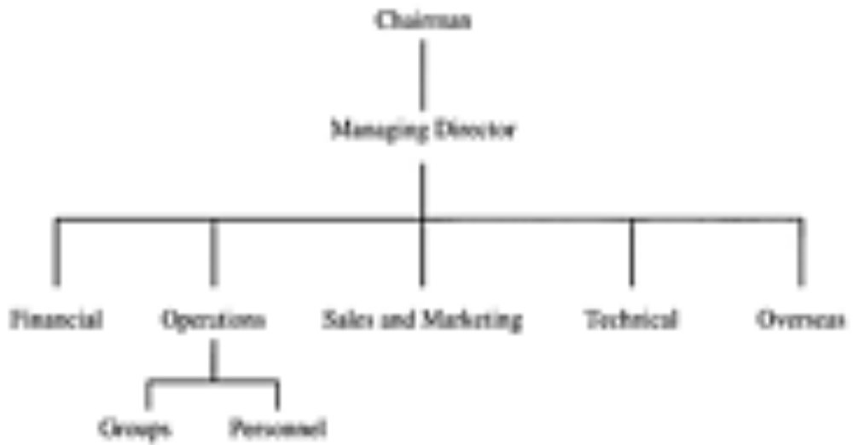
Company Structure

Slide 5
Operations Director
The Operations Director is responsible for all the revenue earning operations of the company.
It is his job to ensure that all projects are completed satisfactorily
And resources are available to carry out the projects that the company wins;
The personnel reports to him.

Slide 6
Technical Director
The Technical Director is responsible for:
Quality management;
Research and development;
Marketing at a technical level (e.g. arranging for staff to give papers at conferences)
Technical training (as opposed to training in, say, project management or presentational skills, which are the responsibility of the personnel function).

Slide 7
Syniad’s Organizational Structure Type
shows elements of all three of the types of organizational structure.
Functional division of responsibilities
Geographical element (represented by the director responsible for overseas operations)
Centralization and decentralization has little meaning (Centralized policies and procedures are widely used but they have usually been developed within one part of the company and have been adopted by general consent.

Slide 8
Centralized vs. Decentralized
In theory, staff have a sense of belonging to a group and regard their group manager as the manager who is permanently responsible for their career in the company.
In practice, because projects often require expertise from more than one group, staff often find themselves working on projects for groups other than the one to which they belong.
In a company of the size of Syniad, the distinction between centralization and decentralization has little meaning. Centralized policies and procedures are widely used but they have usually been developed within one part of the company and have been adopted by general consent.

Slide 9
Management of staff
New employees vs. Old employees…. OUTSIDER
Staff Appraisals:
Employees’ achievements and contributions to the company were properly recorded;
Staff knew what was expected of them and what they needed to achieve in order to gain promotion;
Proper plans for training and career development were made and regularly reviewed;
Employees were aware of the company’s opinion of their performance.

Slide 10
Producing the Budget
Staff in the company are broadly divided into
Technical or Revenue earning staff and
Nonrevenue earning staff
Both require different capital to work.

Slide 11
Monitoring Financial Performance
Monitoring Syniad’s performance against the budget should, in principle, be straightforward.
Each month, the income and expenditure under the various heads are compared and, if significant deviations are observed, corrective action is taken.
In practice, this simple procedure presents many difficulties.
To monitor financial performance, company focuses on;
Cost & Revenue
Project Costing
Sales

Slide 12
1. Costs and revenue
A major problem is caused by random fluctuations, themselves the product of many individual factors, for example:
Annual Budget n Staff hiring
Large projects cause deviation in Budget
Fixed Price Project Estimation

Slide 13
2. Project costing
Because of these difficulties in monitoring the overall performance of the company, Syniad also tries to monitor the financial performance of individual projects, through a project costing system.
The costs and revenue of each project are calculated each month and the cumulative gross margin (i.e. the difference between total costs and total revenue to date on the project) calculated as a percentage of the total revenue.
In practice, this system does not work well.

Slide 14
3. Sales
The budgeted increase in revenue derives partly from increased charge rates, partly from better staff utilization and partly from an increased number of staff.
All these factors are influenced by the forward sales position, that is by the staff required and the rates earned on the work to which the company is committed in the coming months.
Two reports are used for assessing and monitoring the sales position.

Slide 15
3. Sales (Continued…)
The confirmed sales report shows, for each grade, the number of staff in that grade who are committed to contracts in each of the following twelve months and the total expected revenue from that grade in each month.
The sales prospects report shows, for each sales prospect, the potential value of the sale, its likelihood and the likely start date.

Slide 16
Long Term Planning
Strategic Planning for future
The ability to plan strategically and to achieve strategic objectives is the hallmark of well run, successful companies.
Strategic planning in Syniad has two related aspects.
1. The first is to identify appropriate long-term goals
2. Second is to identify and formulate plans to overcome those problems which are inhibiting it from attaining these goals.

Slide 17
Long Term Planning involves
Expansion Plans
Company Image
Product mix (Fee based revenue vs. Package Software)
Finance (under-capitalization)

Slide 18
Conclusions
Syniad, despite its problems, is a successful and well-managed company, however, they need to go multinational.
Do directors have the expertise to manage this transition or to run the resulting company?(agreements for collaboration with comparable companies)
Syniad has now reached a point where it can no longer thrive as a private company and its future must, inevitably, be very different from its past.

Slide 19
Thank you!

